Slide 1

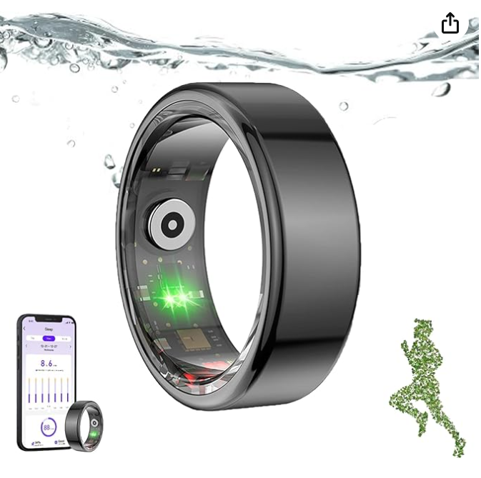

FITNESS RING
Alex Alegre & Irene Sifre

Slide 2

INDEX
Product
Main challenges
Business Objective
Key insights
Data Cleaning Process
Conclusions

Slide 3


PRODUCT AND FEATURES
Features
App Integration
Heart Rate & Vital Sign Tracking
GPS Tracking
Basic Activity Monitoring
Personalized Reminders
Workout Logging
Advanced Health Monitoring
Ring
Lightweight wearable that tracks heart rate, physical activity, etc.

Slide 4

Mission
BUSINESS OBJECTIVE
Our mission is to encourage individuals to lead healthier lives through innovative technology.
Market Research
The goal is to identify the best potential market in Europe to sell the fitness ring.

Slide 5
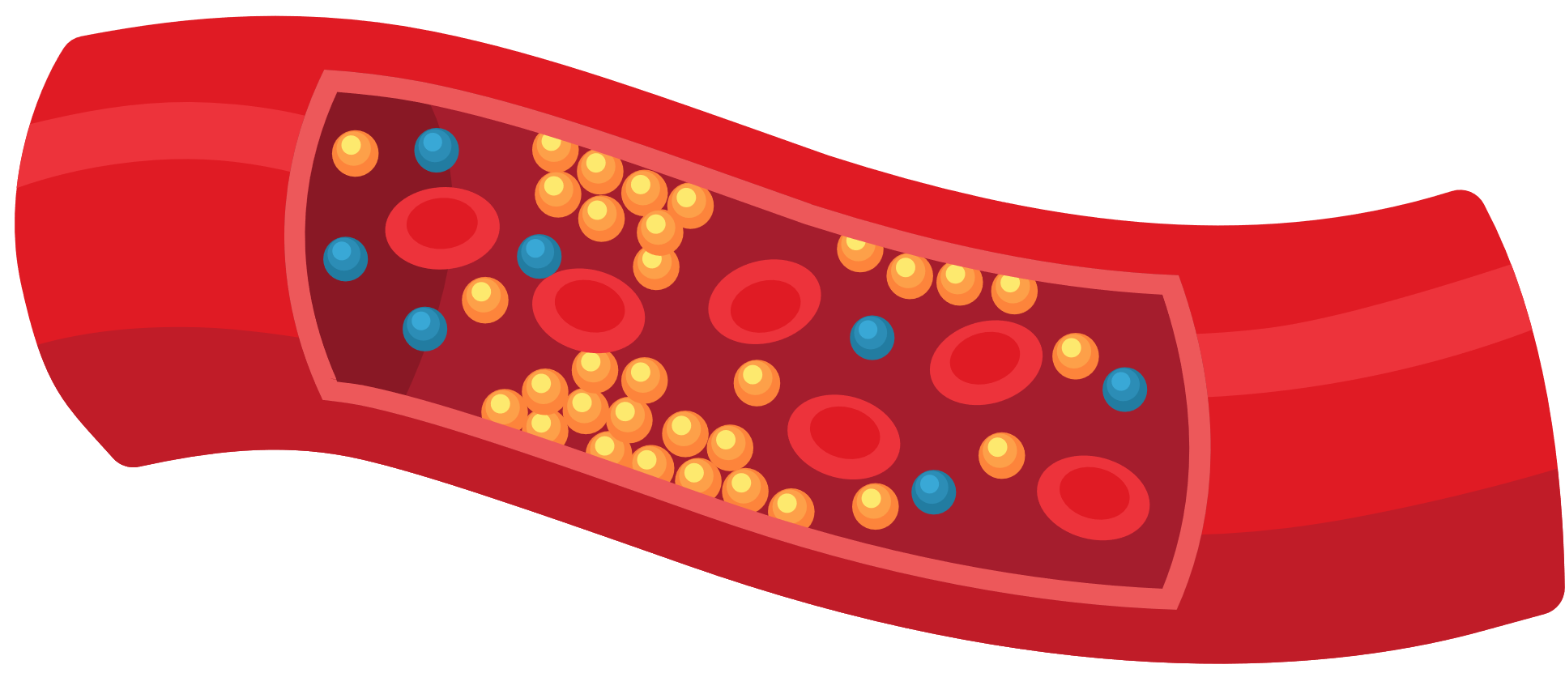
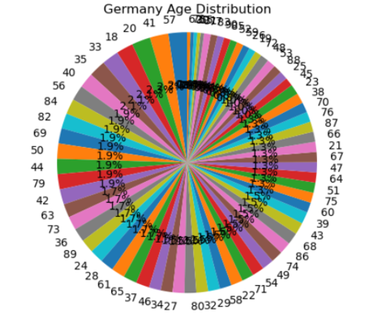
DATA CLEANING PROCESS
Heart Attack Prediction & GDP per country dataset
STEPS:
Loading Data: CSV files were loaded into pandas DataFrames.
Data Type Conversion: Ensured that columns had the correct data types. Removing Duplicates: No duplicates nor null values were found.
Filtering Data: Filtered the dataset to include only relevant rows, focusing on European countries.
Dataset

Slide 6


MAIN CHALLENGES
APIs
World Bank and OECD were explored to obtain additional data related to GDP.
World Bank API was selected.
Data Loading
We encountered issues loading data from GitHub into Python because we used the standard URL instead of the raw file link.
/raw/

Slide 7
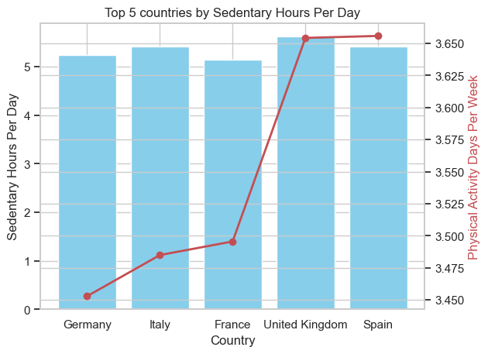
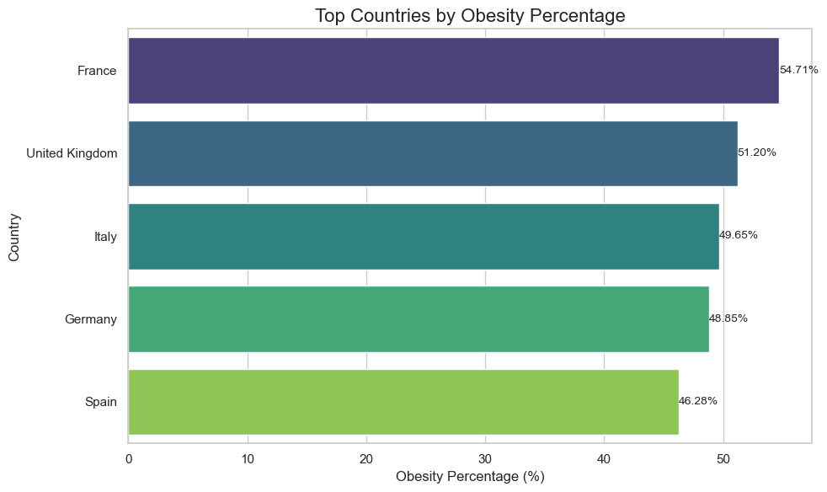
Germany is the country with least sedentary hours and moderate obesity rates.
KEY INSIGHTS

Slide 8
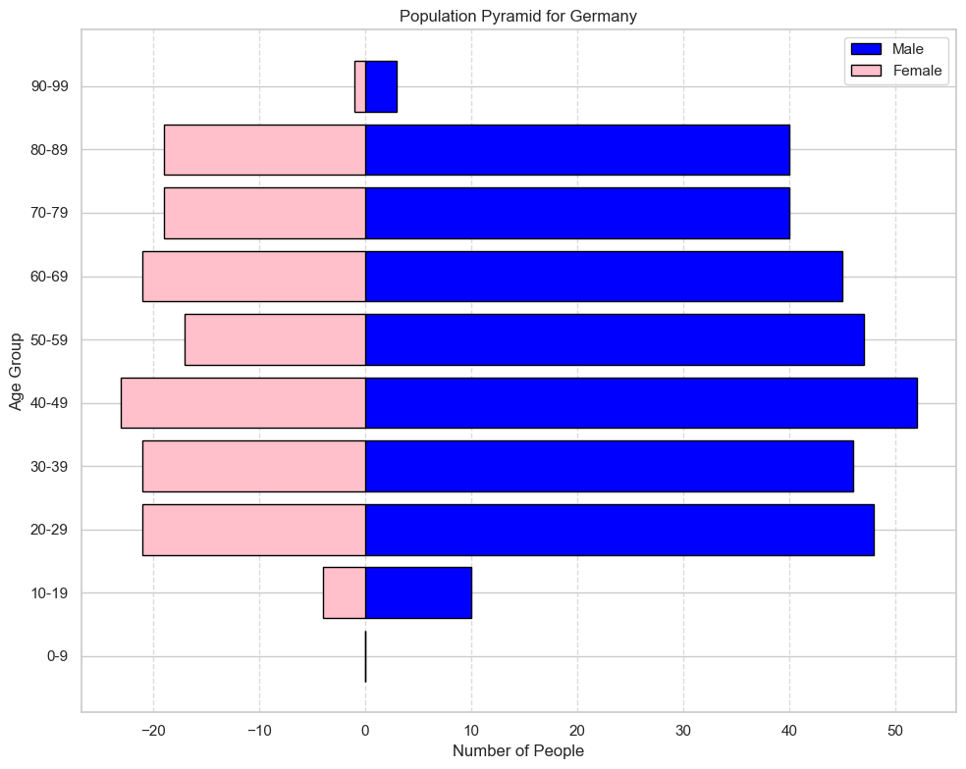
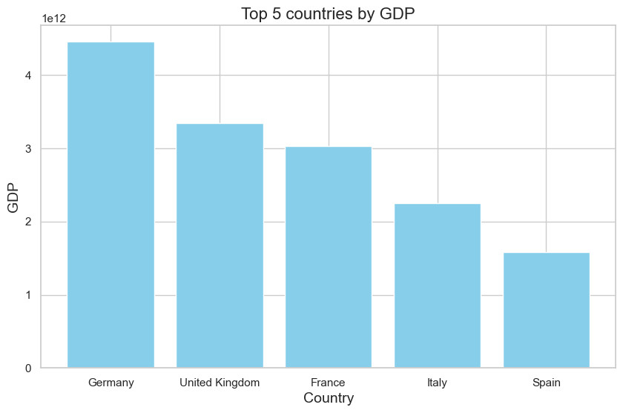
Germany is the countrie with highest GDP. Population pyramid from database.
KEY INSIGHTS

Slide 9



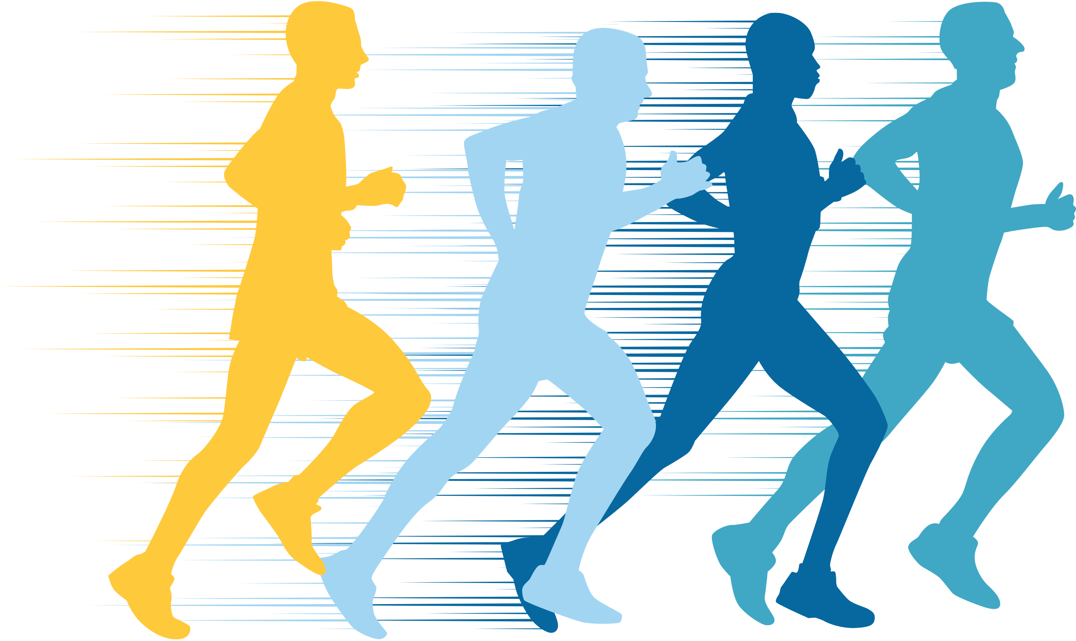
CONCLUSIONS
Germany is the best fit for Fitness R.
Least sedentary (Active)
Moderate obesity rates
Segments per ages.
Fremium strategy for different age cohorts

Slide 10

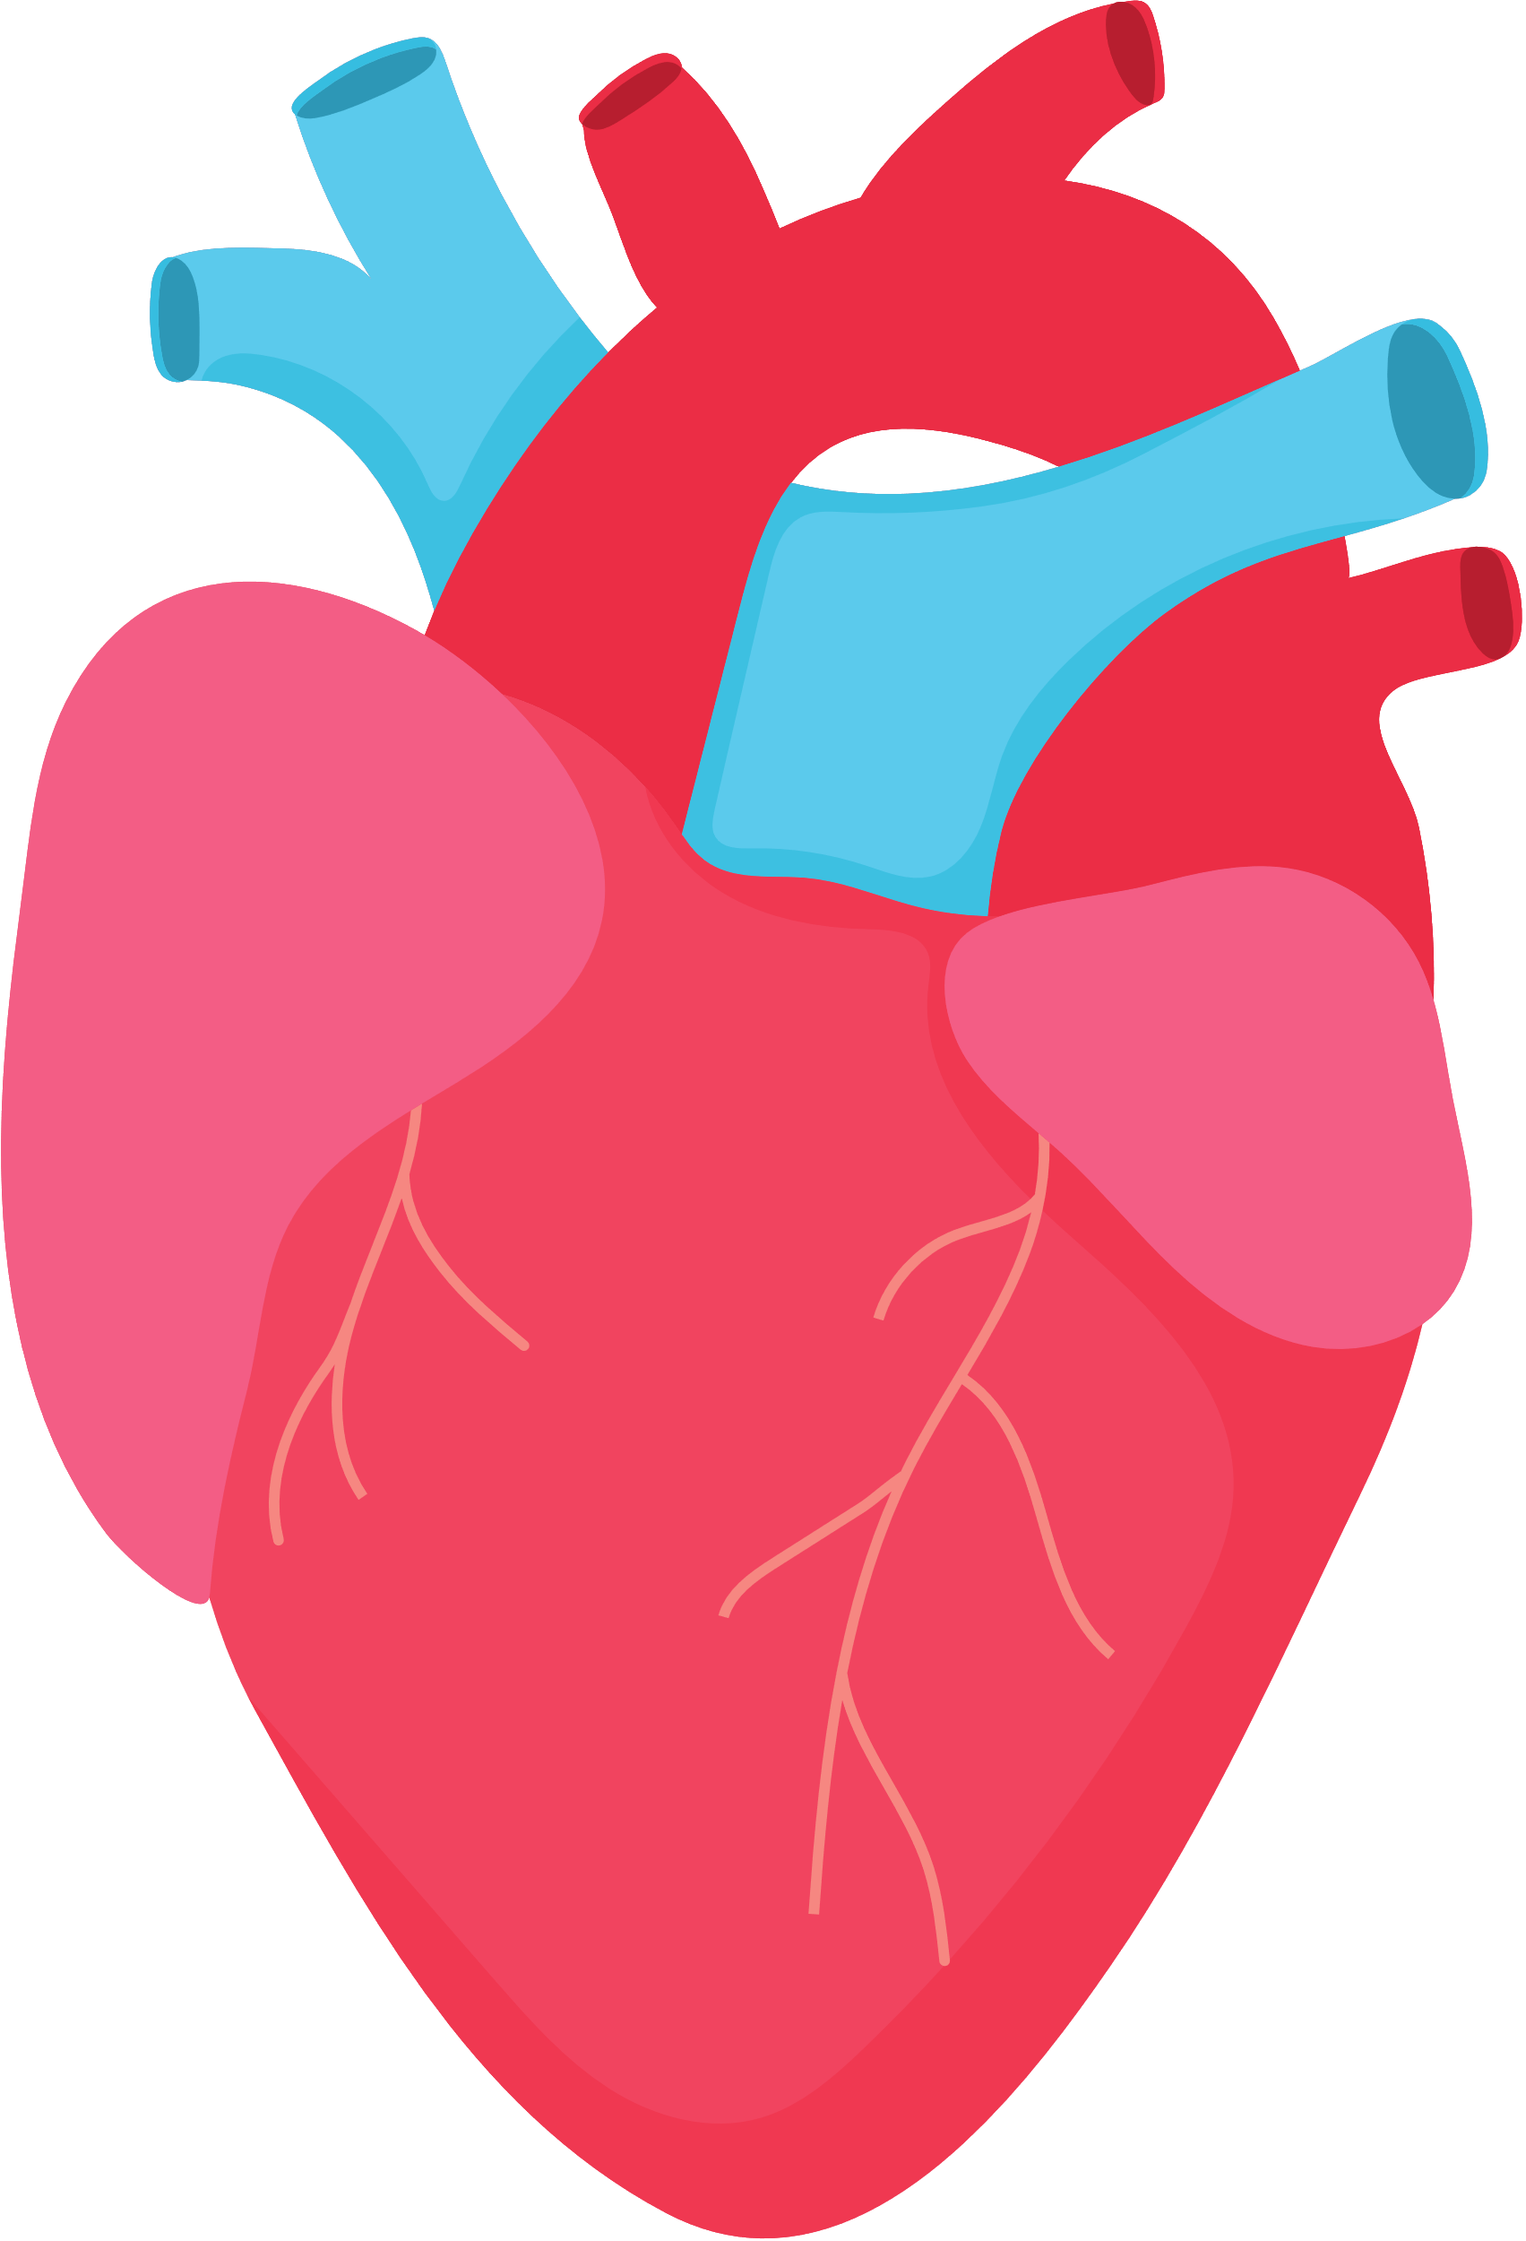

THANK YOU

